Slide 1
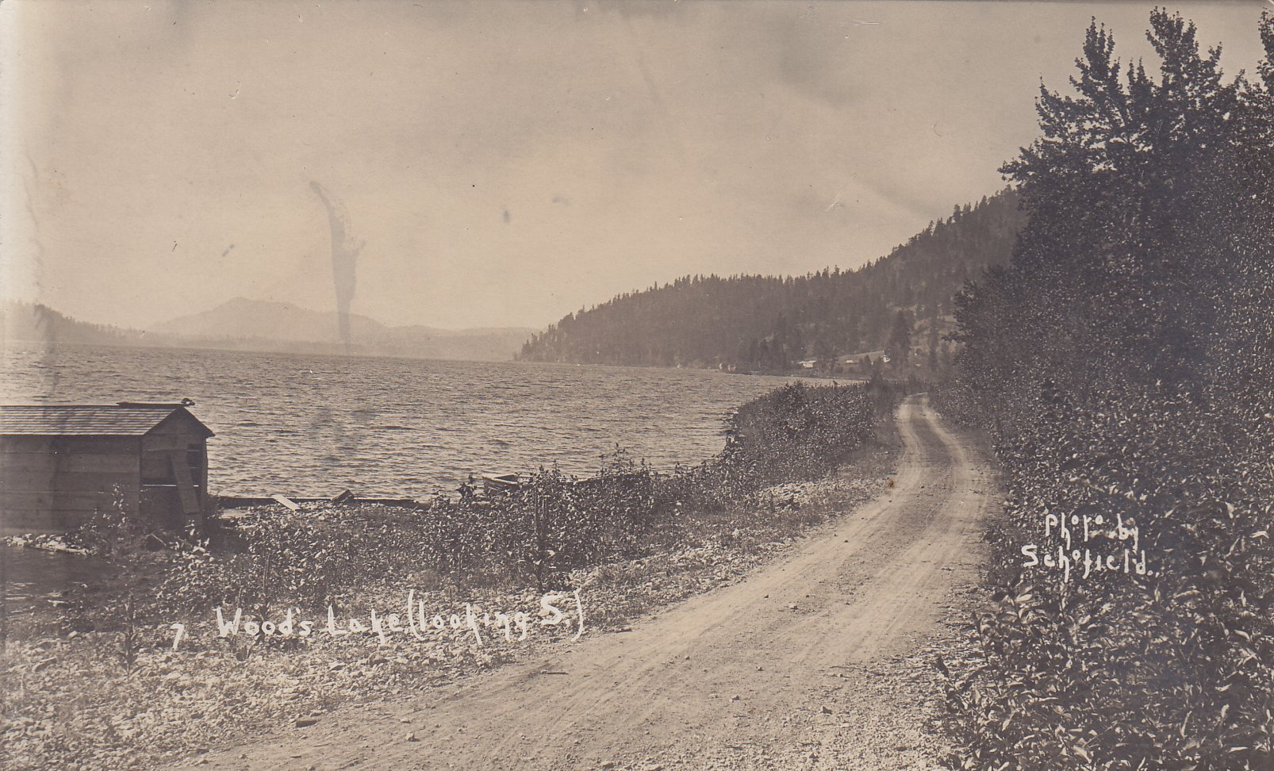
Stagecoach Road

Slide 3
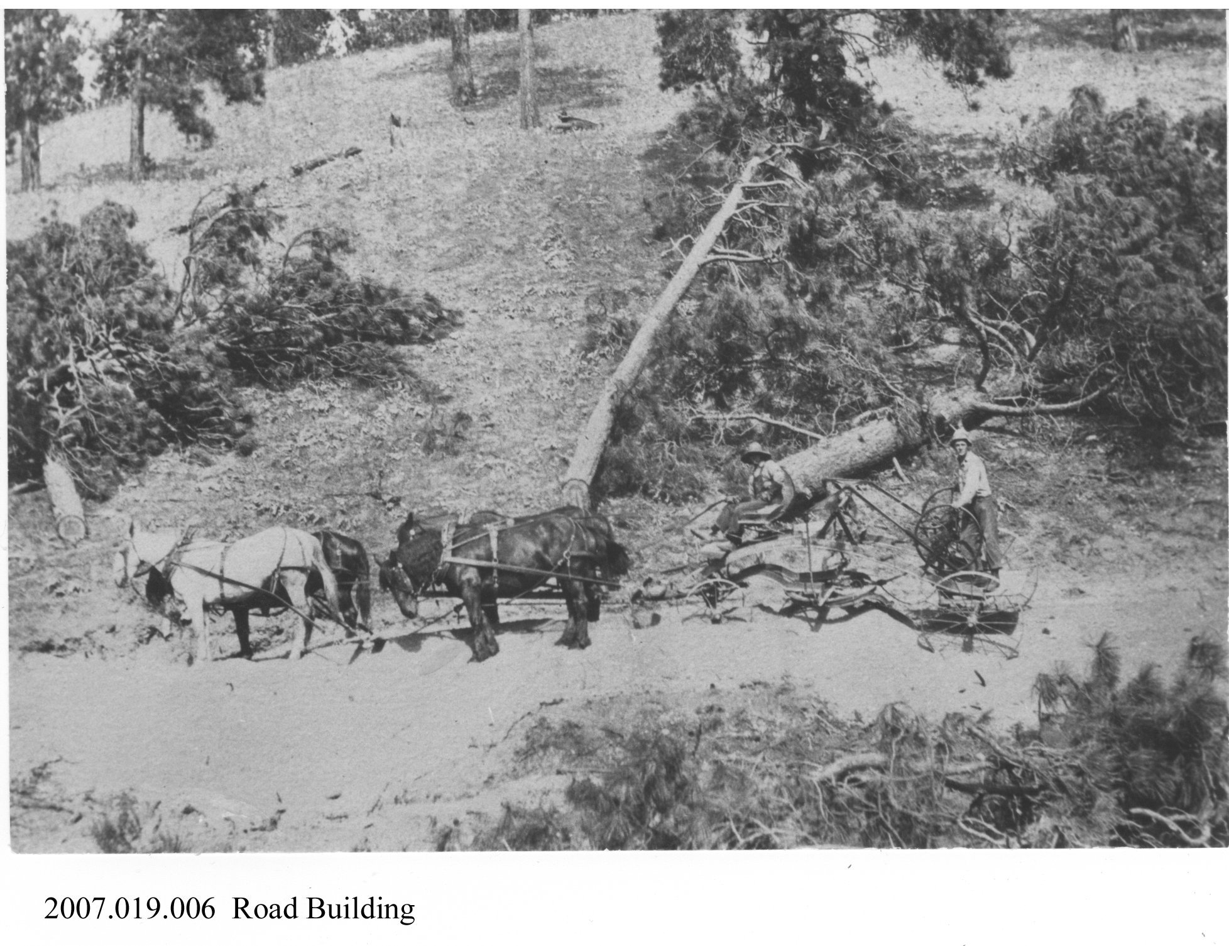

Slide 4
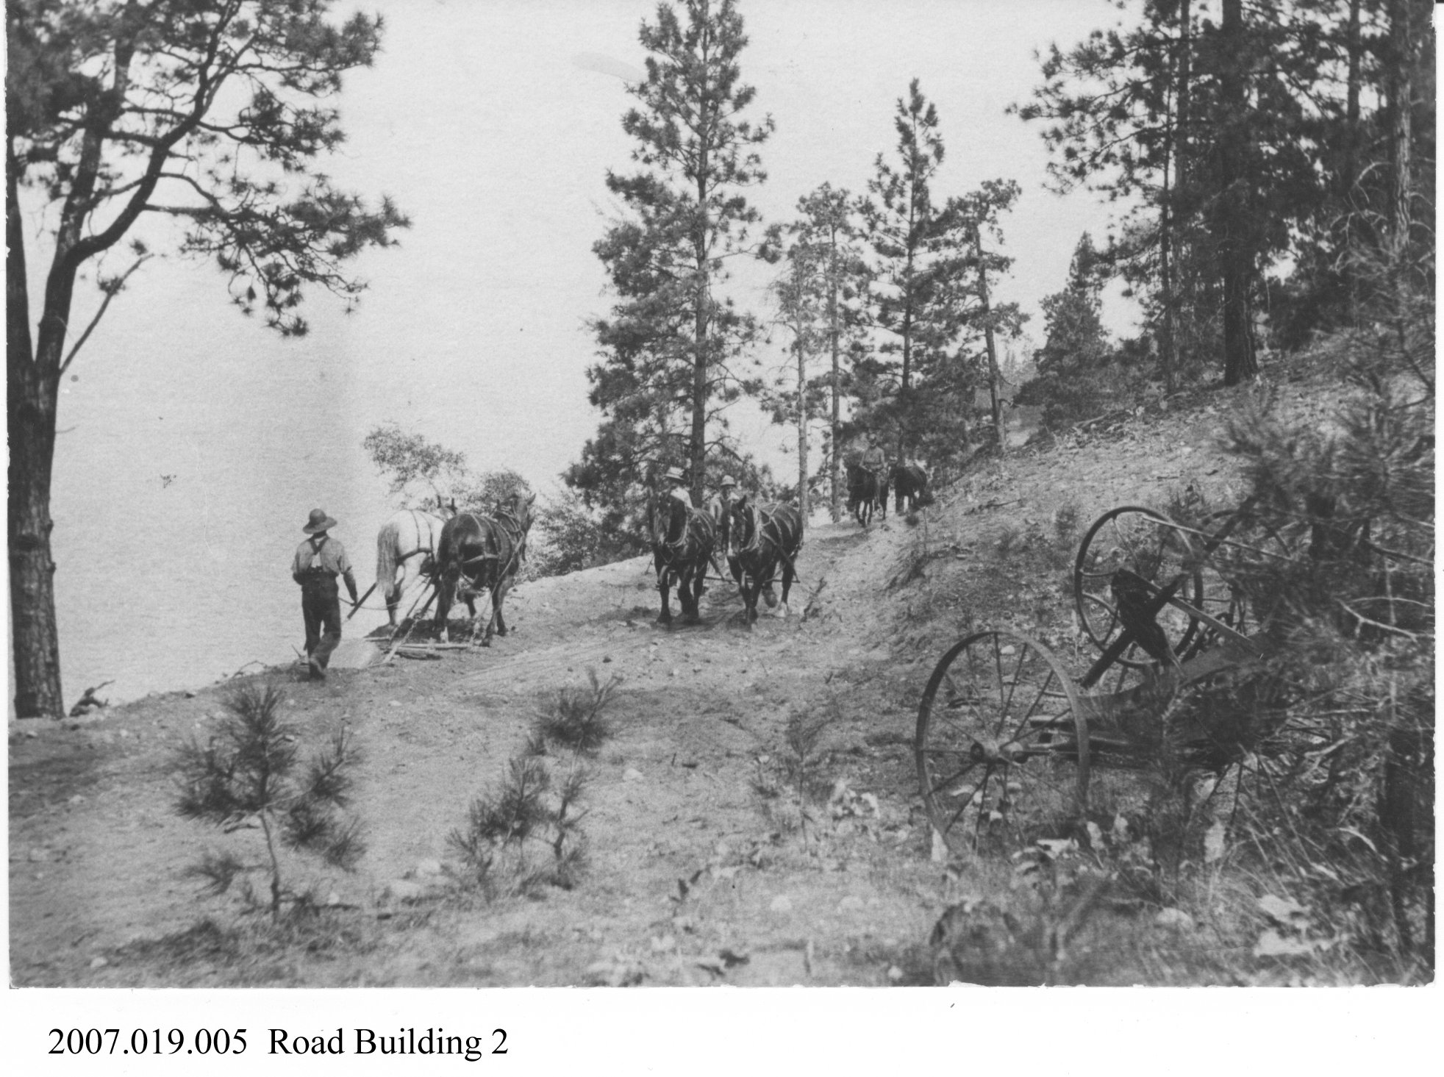

Slide 5
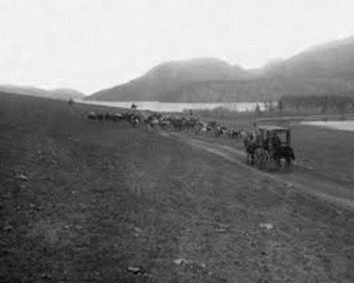
The Vernon to Okanagan Mission Stagecoach Road in 1890

Slide 6
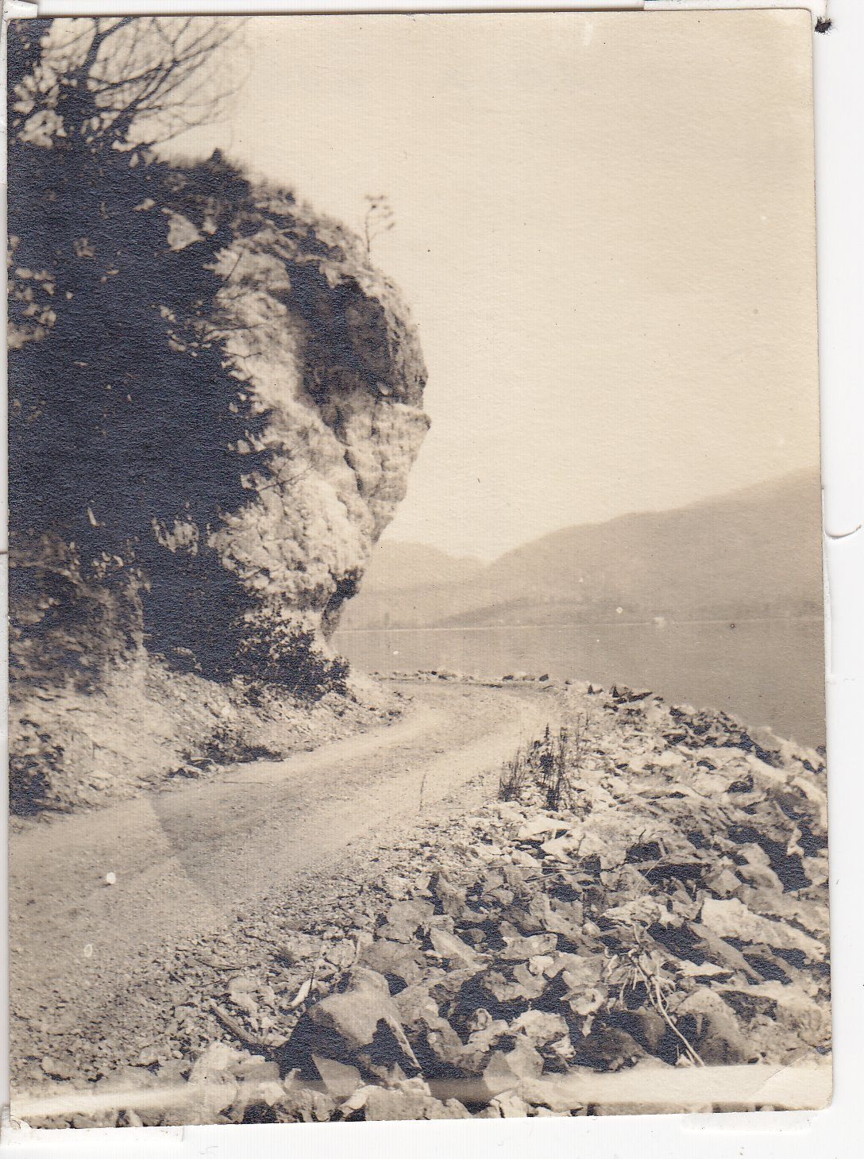
Hwy 97 along Woods Lake north, 1914

Slide 8
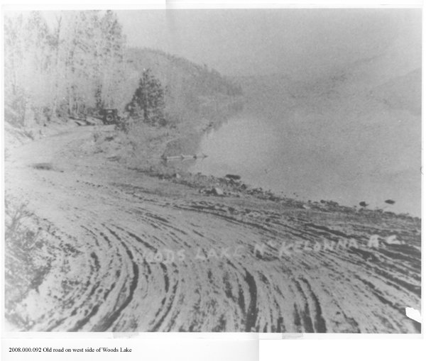

Slide 9
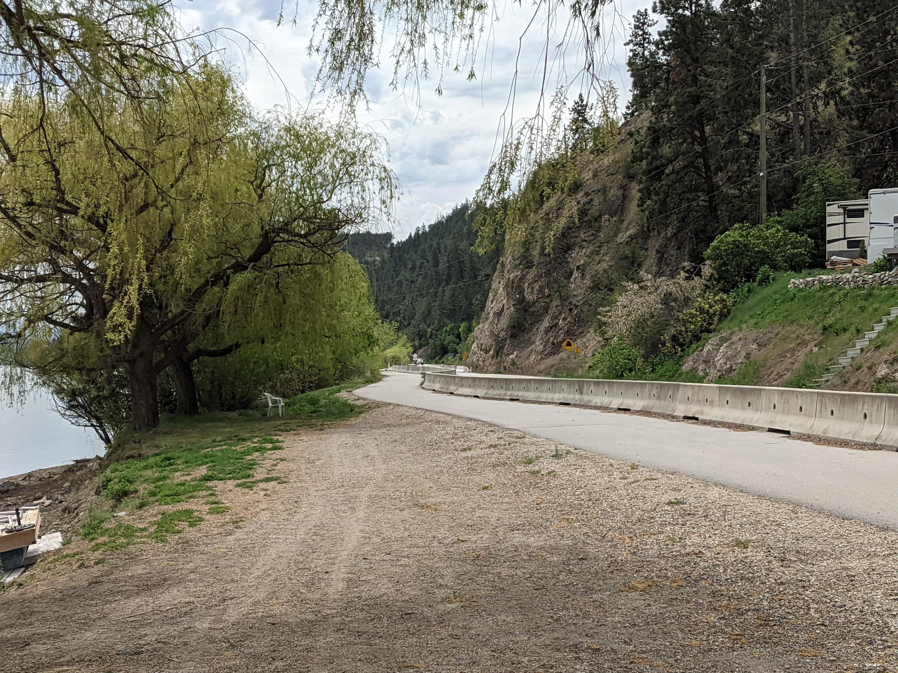
Stagecoach Road as it is today (Railtrail Pelmewash Parkway)

Slide 10
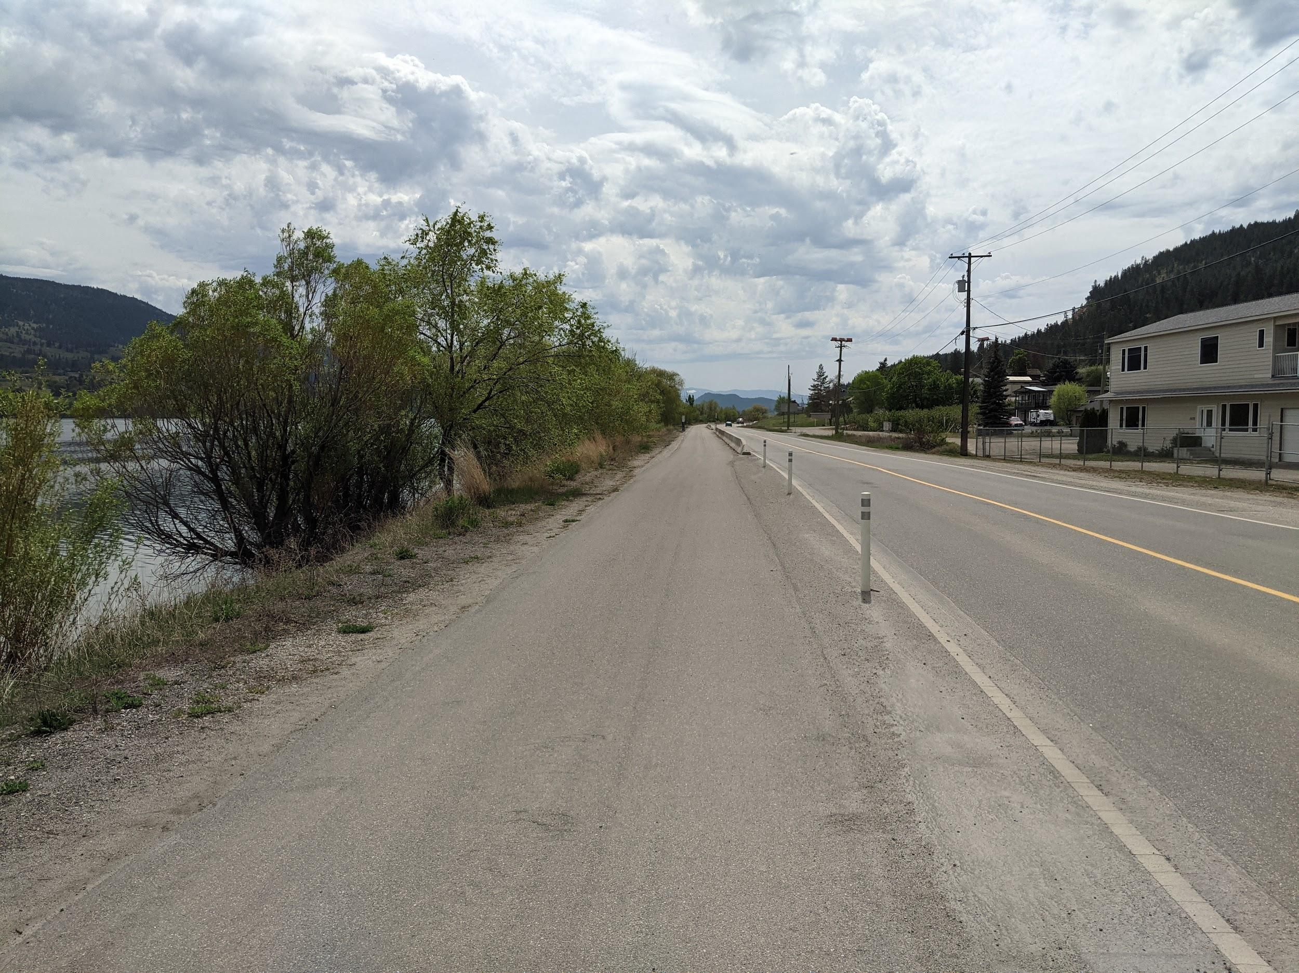
Stagecoach Road as it is today (Railtrail Pelmewash Parkway)

Slide 11
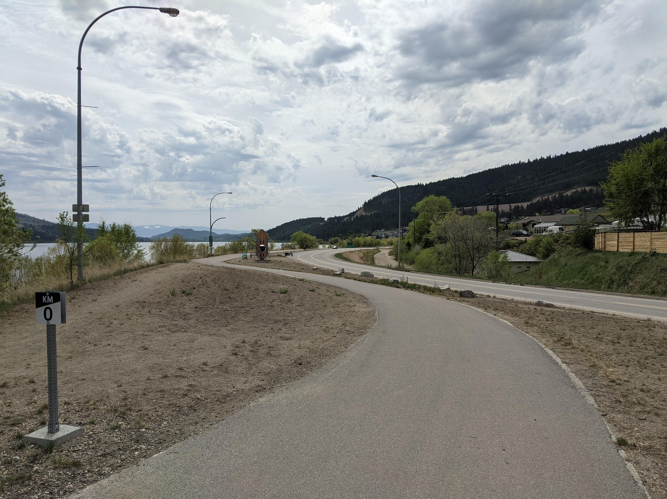
Stagecoach Road as it is today (Railtrail Pelmewash Parkway)

Slide 12
Activity: The Sturdiest Stagecoach
Can you build a Stagecoach that can get two passengers down a road with obstacles?
Notes:
<a href="https://www.vecteezy.com/free-vector/stagecoach">Stagecoach Vectors by Vecteezy</a>

Slide 13
Copyright © 2021
Lake Country Heritage and Cultural Society
11255 Okanagan Center Road West
Lake Country, BC V4V 2J7
All rights reserved. No part of this publication may be produced, stored in a retrieval system, or transmitted, in any form or by any means, electronic, mechanical, photocopying, recording, or otherwise, without prior written permission of the publisher.
https://www.vecteezy.com/

